Slide 1
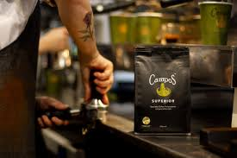
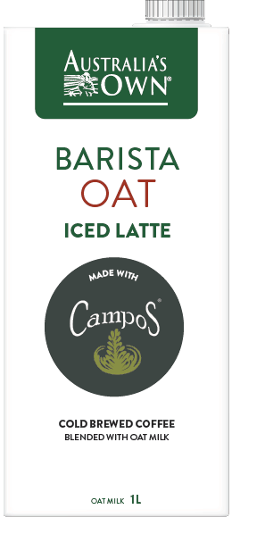
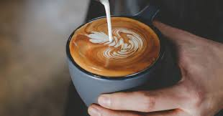
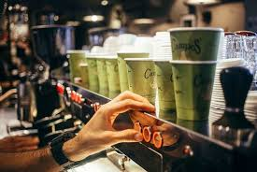
Australia’s Own
Barista Oat Iced Latte
Australia’s Own & Campos specialty coffee have collaborated to create a barista quality, plant-based Iced Latte Coffee to enjoy at home.
If you love the great taste of specialty coffee and creamy Oat Milk, this ready-to-drink Iced Latte is a delicious addition to your breakfast ritual.
Developed by Australia's leading coffee specialists and made with 100% Australian Oats.
Available in 1lt for $4.50

Slide 2

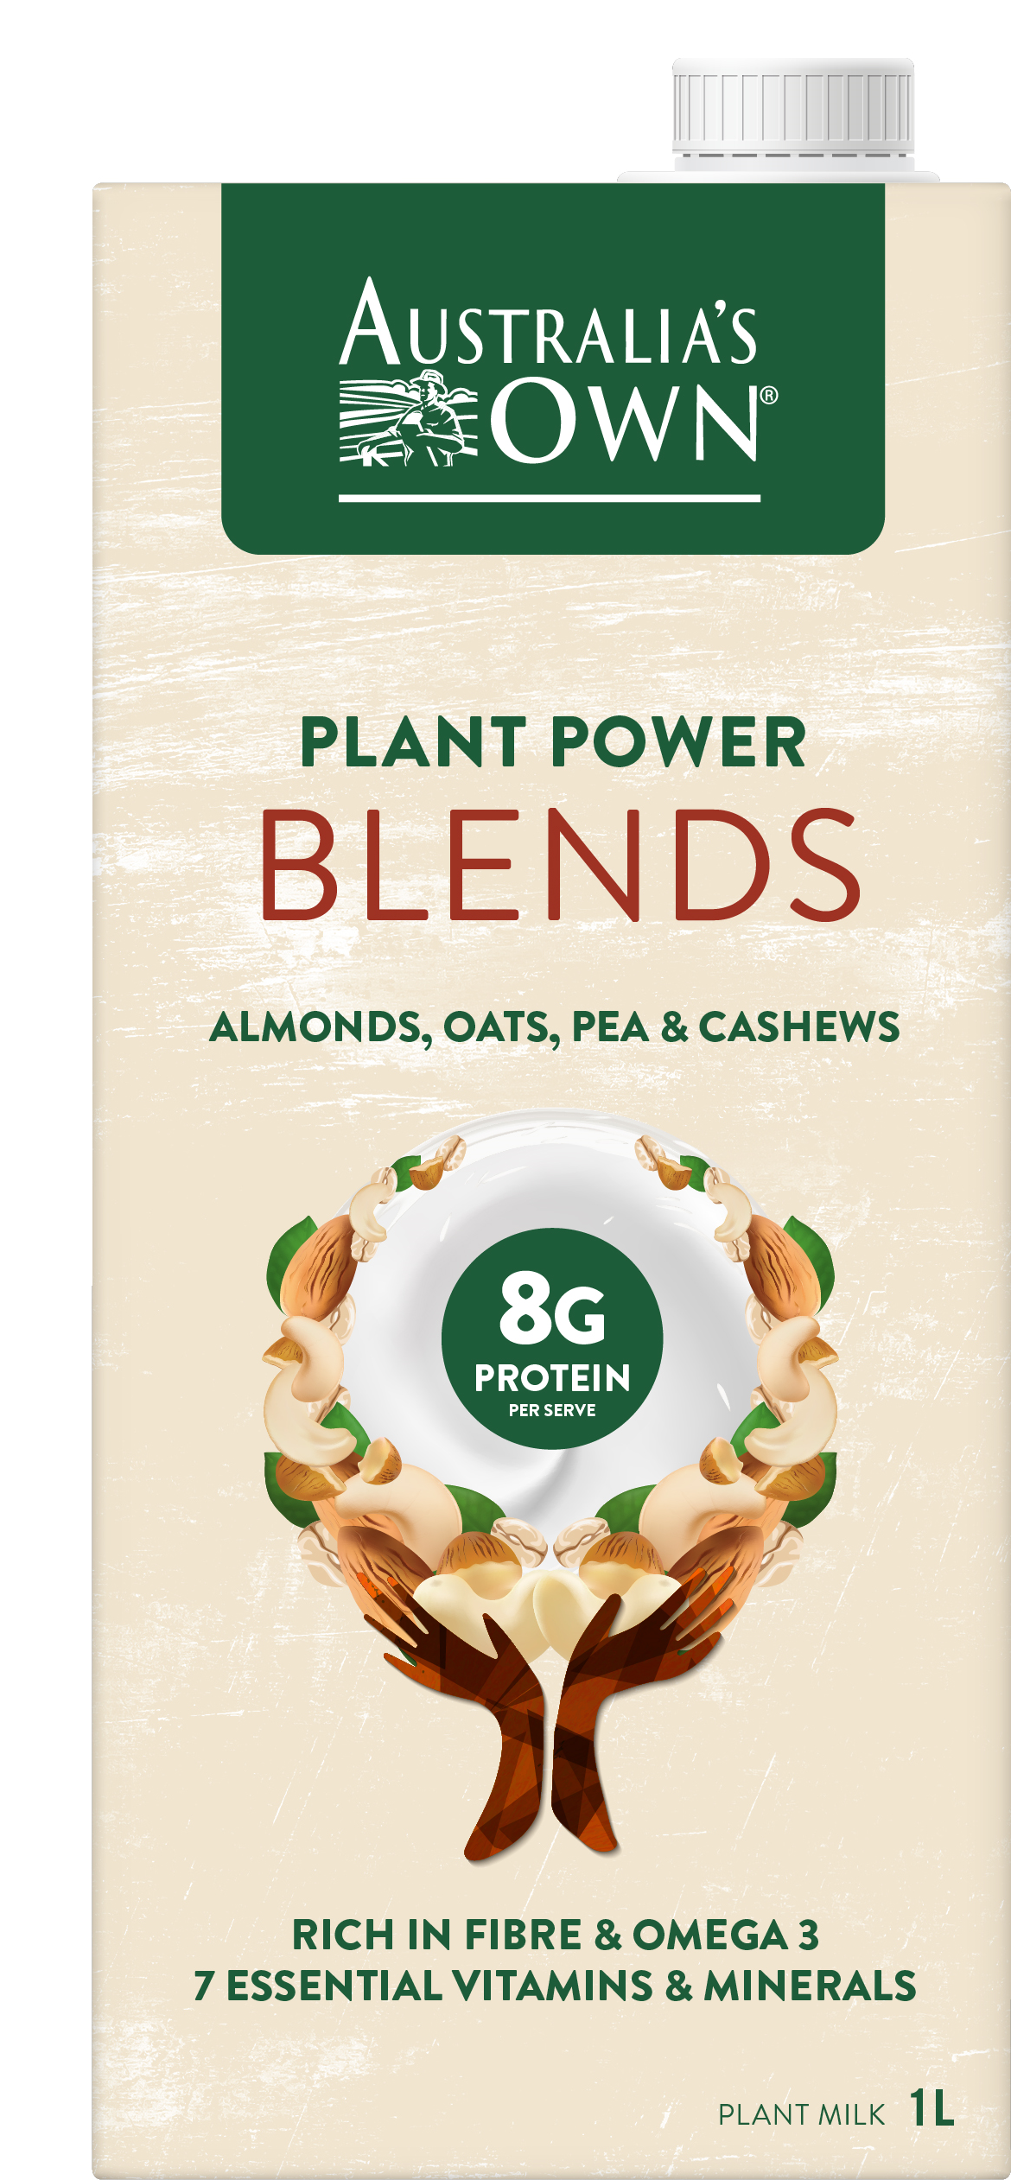
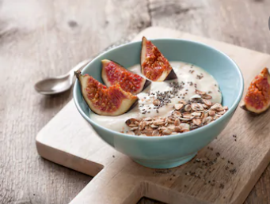
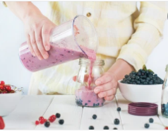
Australia’s Own
Plant Power Blends
Introducing Australia’s Own Plant Power Blends.
This all-in-one nutritional powerhouse is blended from Australian Oats, Almonds, Pea & Cashews with each ingredient contributing an additional source of beneficial plant nutrients.
With a delicious taste, this blend packs a powerful punch with 8g plant-protein, plant-fibre, healthy fats and 7 essential vitamins and minerals.
Available in 1L for $4.50

Slide 3
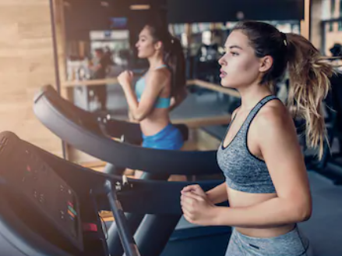
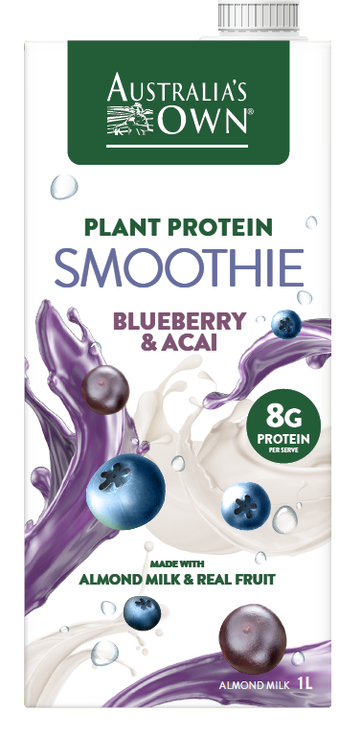
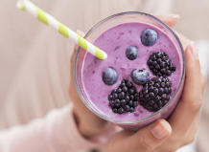
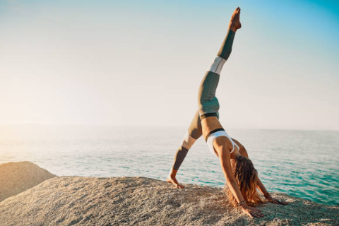
Australia’s Own
Plant-Protein Smoothies
Supercharge your day with our delicious range of Plant-Protein Super Smoothies by Australia’s Own.
Packed with plant nutrients, these convenient ready-made smoothies take the hard work out of preparing a healthy breakfast.
Diary Free and blended with delicious real fruit, almond milk, plant-fibre, 8g pea plant protein. Available in Blueberry & Acai and Banana & Mango 1lt packs for $4.50.

Slide 4
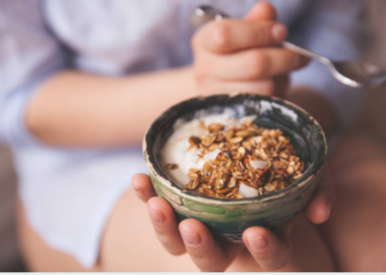
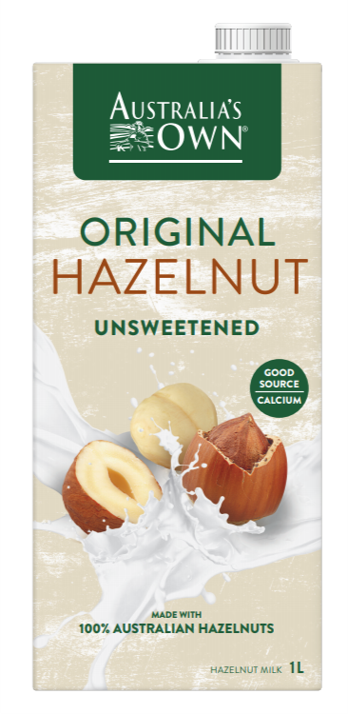

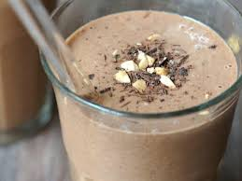
Australia’s Own
Hazelnut Milk
Hazelnuts are bursting full of nutrition goodness making them a great plant-based milk alternative.
Australia’s Own Original Hazelnut milk tastes delicious and is nutritionally rich in healthy fats, fibre, antioxidants, Vitamin A, B and E for optimal health and well being.
Made with 100% Australian certified organic Hazelnuts and naturally free from Diary, lactose or cholesterol, low in sugar and a good source of Calcium. Available in 1lt for $2.80

Slide 5

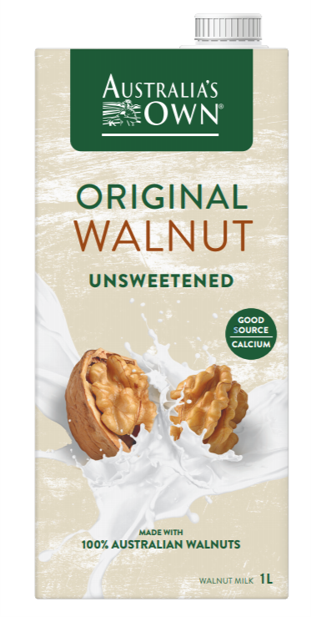
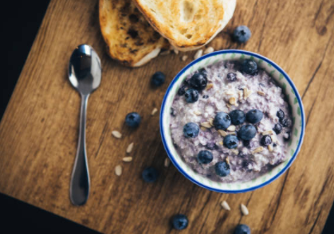
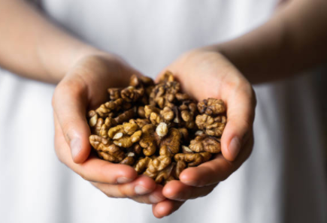
Australia’s Own
Walnut Milk
Walnuts are bursting full of nutrition goodness making them a great plant-based milk alternative.
Introducing Australia’s Own Original Walnut Milk with a rich nutty flavour. Packed full of healthy Omega 3’s, Protein, Vitamin E and Anti-oxidants for optimal health and well being.
Made with 100% Australian certified organic walnuts and naturally free from Diary, lactose or cholesterol, low in sugar and a good source of Calcium. Available in 1lt for $2.80

Slide 6

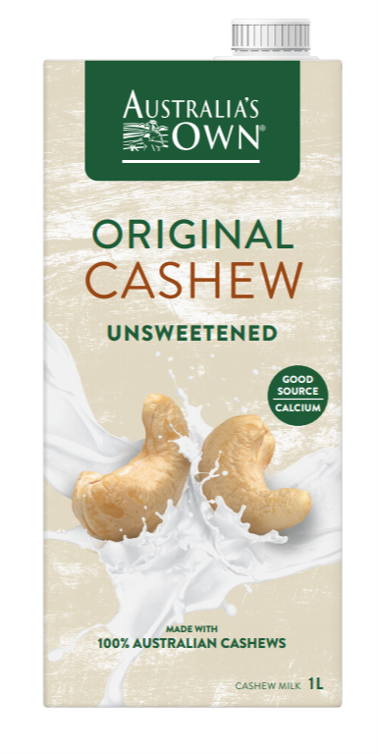
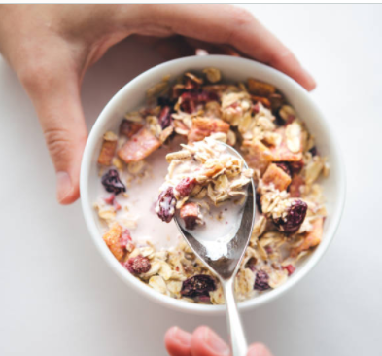
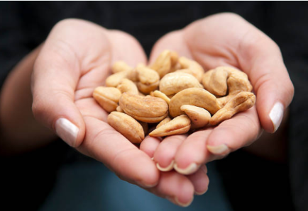
Australia’s Own
Cashew Milk
Simple, Organic, Delicious
Australia’s Own Cashew Milk is made with 4 simple ingredients and 100% Australian certified organic roasted cashews.
Naturally free from Diary, lactose or cholesterol low in sugar and a good source of Calcium our Cashew milk has a rich creamy texture, delicious depth of flavour.
Available in 1lt for $2.80

Slide 7
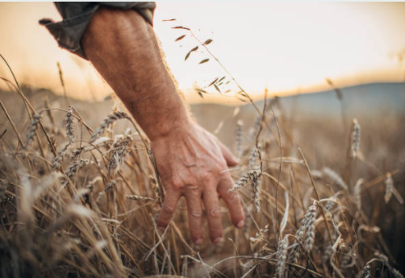
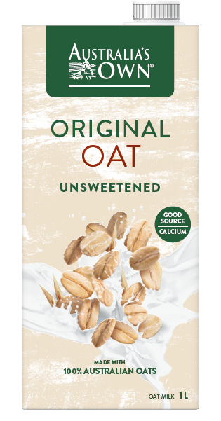
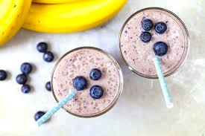
Australia’s Own Original Oat Milk
Introducing Australia’s Own NEW Oat Milk, a deliciously creamy Oat milk made from the goodness of 100% Australian Oats.
Made with 4 simple pure ingredients our Oat Milk is naturally free from dairy, low is saturated fat, cholesterol, lactose, no added sugar or preservatives so you can feel naturally good.
Available in 1lt for $2.80

Slide 8
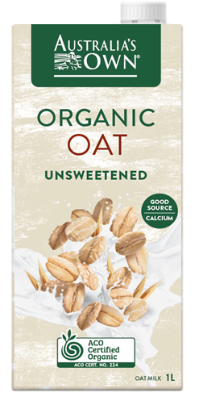
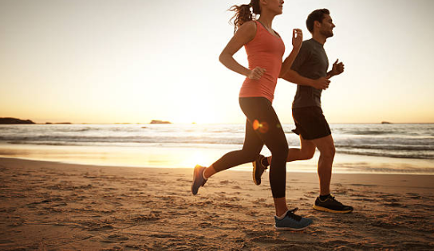
Australia’s Own Organic Oat Milk
Introducing Australia’s Own NEW Organic Oat Milk.
Made with 4 simple pure ingredients, 100% certified Australian Organic Oats, naturally free from dairy, cholesterol, low in saturated fat and contains no added sugar or preservatives so you can feel naturally good.
Available in 1lt Cartons for $2.80

Slide 9

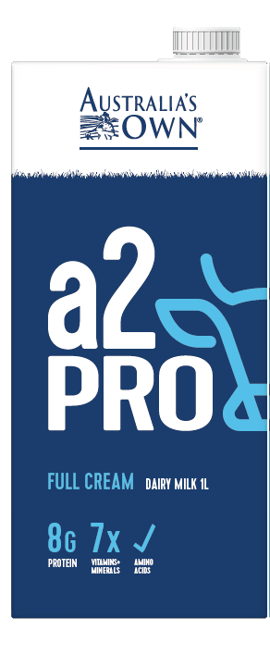
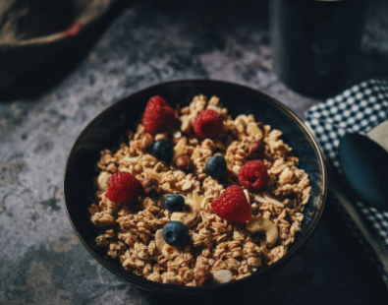
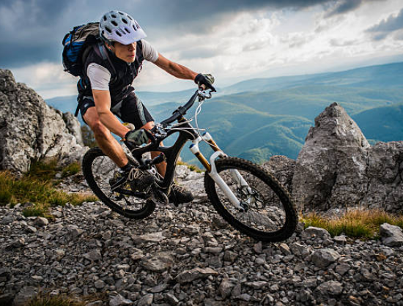
Australia’s Own
a2 Pro Protein
We know the difference high-quality nutrition can make to your overall health, which is why we’ve created Australia’s Own a2 Pro Protein milk.
Through our ultra filtration process our a2 Pro Protein contains twice the protein of standard milk, with the natural a2 dairy benefits of 7 essential vitamins & minerals, so you can fuel you day with better nutrition and feel the difference.
Available in 1L packs for $3.00 in the long-life milk aisle.

Slide 10
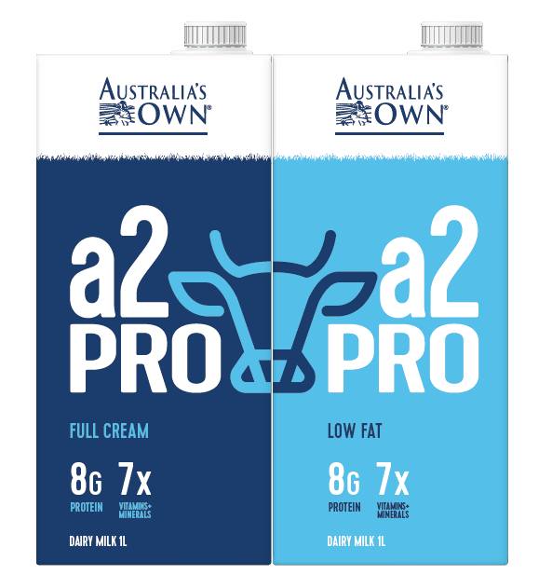

Slide 11

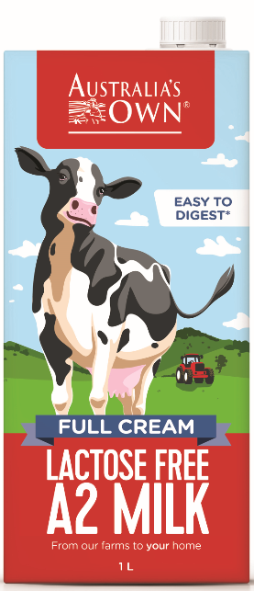

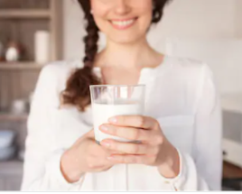
Australia’s Own a2 Lactose Free Milk
Introducing Australia’s Own a2 LACTOSE FREE Milk, all the goodness of regular a2 full cream milk without the lactose, making it easy to digest for those sensitive to dairy.
Australia’s Own a2 Lactose Free helps break down the lactose into simple natural sugars, that way your body doesn't have to. So now you can enjoy the great taste of a2 dairy milk and feel positively good.
Available in Full Cream and Low Fat 1L for $2.20

Slide 12
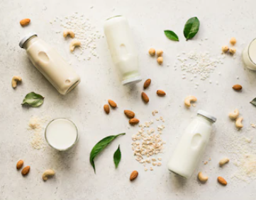
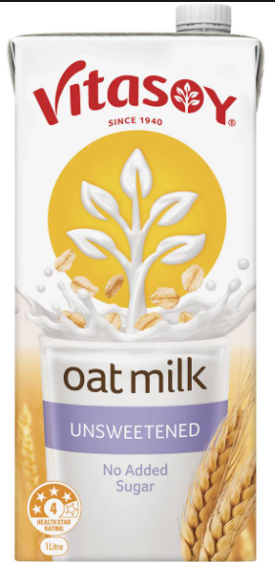

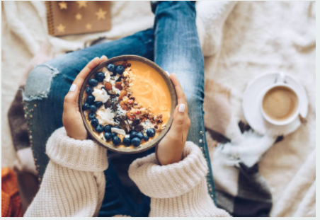
Vitasoy
Oat Milk
Vitasoy Oat Milk Unsweetened is brimming with the goodness of real oats.
Deliciously rich and creamy, our oat milk is made from Aussie oats and free from cholesterol and lactose. Plus there’s no added sugar, artificial colours, flavours or preservatives, so you can savour every sip.
Available in 1L packs for $2.90

Slide 13
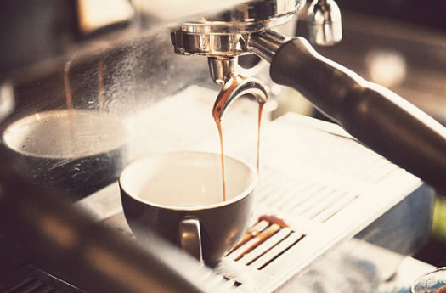
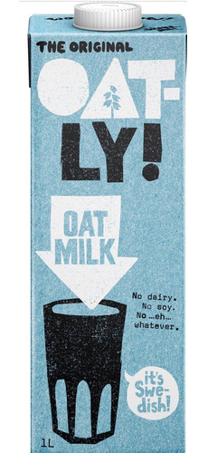

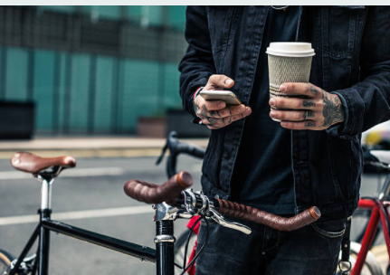
Oatly
Oat Milk
Introducing Oatly, Swedish Oatmilk that’s oatlicious.
Oatly is made from 100% whole oats and loaded with nutritional goodness (protein, carbs, fibre and healthy fat) and beta glucans, big scientific word for soluble fiber for good heart health.
Available in 1L packs for $4.50

Slide 14
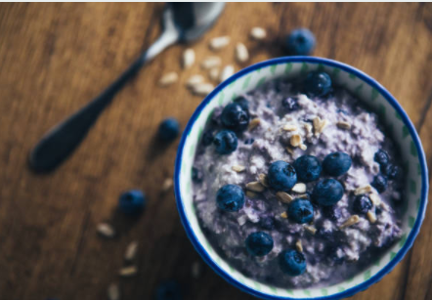
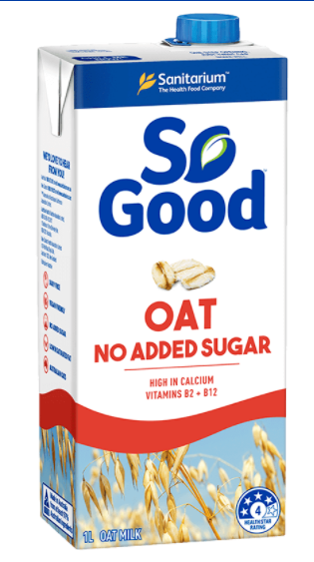
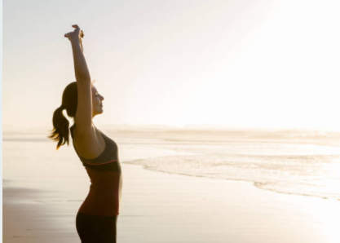

So Good
Oat Milk
From the number one plant-based milk introducing So Good Oat Milk our creamiest plant milk yet.
Packed with the goodness of oats, perfect for smoothies, baking, cereals and so much more! It’s high in calcium and vitamins B2 and B12, plus it tastes delicious!
Available in 1L packs for $2.70

Slide 15
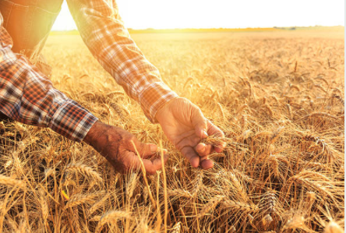
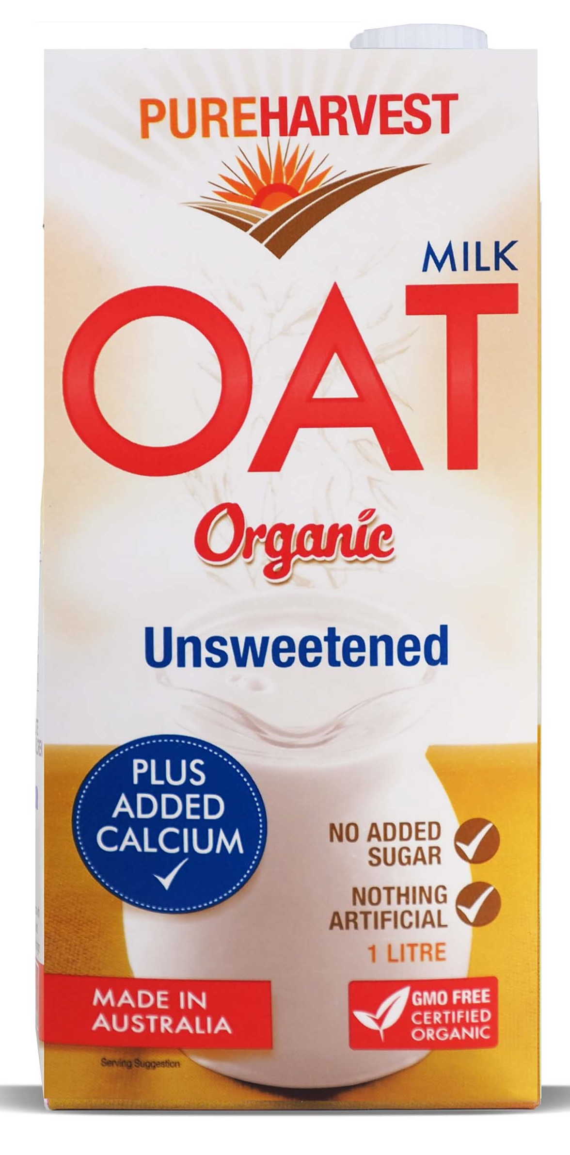
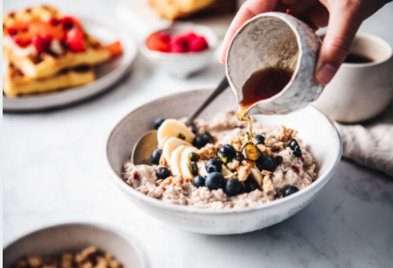
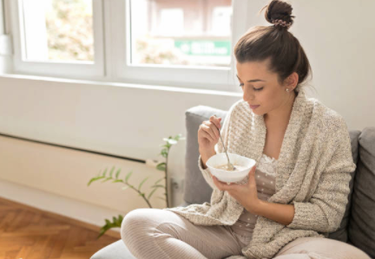
Pure Harvest
Oat Milk
Simple, Organic, Delicious
Pure Harvest Organic Oat is made from 100% whole organic oats and all organic ingredients fortified with calcium for healthy bones and no added sugar for a mild natural oat flavour.
Available in 1L packs for $2.80

